Slide 1

Lists
Notes:
Welcome back to another fun-filled, action-packed Programming I lesson. Today, we will be covering lists, which is the way Python stores a bunch of values in a specific sequence. You’ve definitely encountered lists in real life before: To-do lists, shopping lists, naughty or nice lists, and so. After this lesson, you should be able to use lists in your Python programs.

Slide 2
Objectives
At the end of this lesson, you will learn how to:
Create Lists
Process Lists using List operators and functions
Notes:
What we will do in this lesson is show you how to create your own lists in Python. Once that is done, we will teach you all kinds of neat things that you can do with lists in your programs using operators and functions.

Slide 3
What is a List?
A list is considered a sequence type in Python, similar to Strings.
A list is a sequence of values.
In a string, the values are characters.
In a list, the values can be any type.
Values in a list are called elements or items.
string friend
P
e
t
e
r
Index
0
1
2
3
4
list friends
Peter
John
Mary
David
Index
0
1
2
3
Notes:
So what is a list in Python? Essentially, a list is a collection of values in a specific sequence. This is very similar to strings, which you can think of as a list of characters. However, the values in a list can be of any type. We call the values in a list elements or items.
In this example, we have a string called friend containing the value ‘Peter’. We can construct a list of strings, and put Peter as one of the elements in the list. Lists are really versatile that way.

Slide 4
Examples of List
Names of your friends
List of students' marks
Text document – a list of lines
Peter
84.7
David
71
Vincent
55
Hafiz
80
Janet
63
Albert
….
….
S9099885K;Ang PS;98765432
S9177885P;David Davis;89778899
S9267890A;Lim Vincent;91990099
S9111199Q;Tan SS;88995566
….
Notes:
So, what can you put in a Python list? Practically anything. You could have lists of strings containing your friends’ names. You could have lists of numbers containing student marks, and in Python you can put integers and floats together in the same list.
Later on, when you learn how to read files, you can read all the lines in a spreadsheet and store them as strings that are separated by some symbol such as semi-colon. You can then read each item from the list and use your string manipulation tricks to get the data you need.
Basically, as long as you want to collect a bunch of values together and possibly have them retain their sequential order, use a list.

Slide 5
Creating a List
Enclose the elements in square brackets, separate each element by commas.
E.g. [ ]
[ 'Peter', John', 'Mary', 'David' ]
[ 89, 77, 55, 69 ]
Usually we assign the list to a variable name so that we can refer to the list subsequently:
E.g. empty_list = [ ]
friends_list = [ 'Peter', 'John', 'Mary', 'David' ]
marks_list = [ 89, 77, 55, 69 ]
Notes:
To create a list in Python, all you need is a pair of square brackets, and inside the square brackets you separate each element using commas. For example, an empty list is just a pair of square brackets with nothing in them, but you can always add stuff into your list later. This is a list containing 4 strings, and this is a list containing 4 integers.
Usually we will want to assign the list to a variable name so that we can access it later, so you might call these empty_list, friends_list and marks_list, respectively.

Slide 6
Creating a List
An element in a list can be another list – nested list.
E.g. friends_list = ['Peter', ['John', 'Mary'], 'David']
matrix = [ [1,2,3], [4,5,6], [7,8,9] ]
A list that contains no elements is called an empty list.
E.g. empty_list = [ ]
A list may contain elements of different types.
E.g. mixed_list = ['Peter', 100, 23.5, [10, 20]]
Notes:
What kinds of things can you put into a list? Like I said before, practically anything. You can even put a list into a list. For example, in this list, element zero is the string ‘Peter’, element 1 is the list containing two strings ‘John’ and ‘Mary’, and element 2 is the string ‘David’. Because, you know, ever since John and Mary started going steady, they might as well be one person, and then someone is not free for game nights anymore. I’m not jealous at all.
Here’s another example where the list matrix contains three lists, and each of the lists it contains is itself a list of integers. This is how Python would handle a 3x3 matrix using a list. Lists that contain lists are also called nested lists.
We call a list that contains no elements an empty list, created using just a pair of square brackets. This is pretty common, because you often want an empty list to start, and then start adding stuff to the list as the program runs.
Python lists are really versatile because a single list can contain elements of many different types. mixedList contains the string ‘Peter’, the integer 100, the float 23.5 and the list containing two integers 10 and 20, all living in perfect harmony. While you would rarely require putting different types of elements in a list, it’s nice that Python allows you to do that.

Slide 7
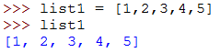
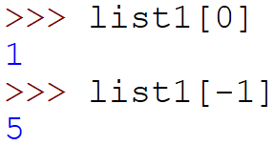
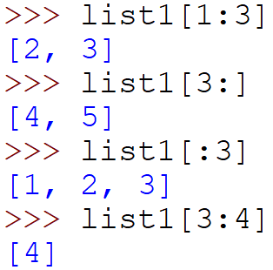
Basic Operators for List
Use the bracket operator [n] to access an element in the list.
Use the [n:m] operator to access part of the list from index n to m.
Usage is similar to Strings
Notes:
Now that we have learned how to make lists, lets talk about the things that we can do with a list. Many of the basic operators for a list are the same as for a string. For example, you can use the square bracket operator to access an element in a list, so if list1 contains 1, 2, 3, 4, 5, then list1[0] gets you 1, and list1[-1] gets you the last element in the list, which is 5.
You can also use the colon operator within the square brackets to get sublists, the same way you use it in strings to get substrings, so these examples give these results. Note that the colon operator always returns a list, so even if the slice contains only one element, you will get a list containing one element, not the element itself. So in the last statement in this example, list1[3:4] returns a list containing the integer 4, not the integer 4 itself.

Slide 8
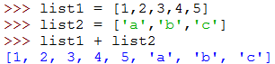
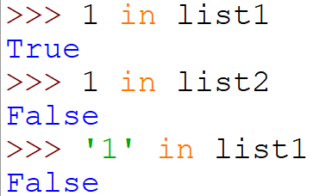
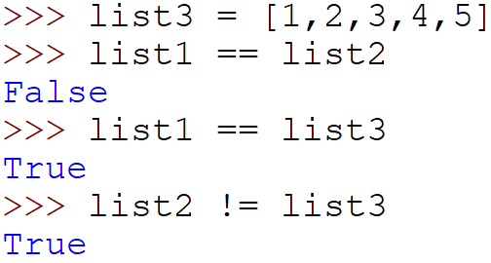
Basic Operators for List
+ operator concatenates lists.
in operator detects the presence of an element in the list.
== operator compares if two lists are equal;
!= operator compares if two lists are equal
Notes:
Here are a few more basic list operators. You can use the plus operator to concatenate two lists. In this example, list1 + list2 creates a single list containing all the elements in list1 followed by all the elements in list2.
The in operator detects if an element is in the list, and returns True or False. So 1 is in list1 but not in list2. Also note that type matters, so the character ‘1’ is not in list1.
You can use the equal operator, which is two equal signs, to check if two lists are identical. Two lists are identical if and only if all their elements are the same, and in the same position in the list. In this case, list1 and list2 are not equal, but list1 and list3 are equal. The opposite of this operator is the not equal operator, which is exclamation point equal. You know how this works.

Slide 9
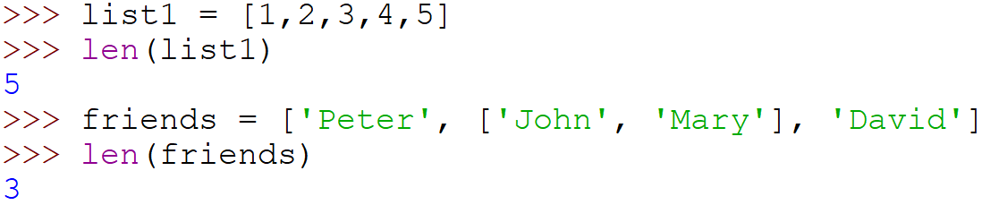
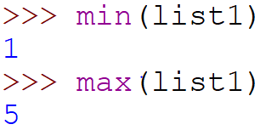
Basic Functions for List
function len() returns the number of elements in the list.
function min() returns the smallest element in the list.
function max() returns the largest element in the list.
Notes:
Here are a few more basic list functions. Just like for strings, len returns the number of elements in the list, so in this case, len(list1) returns 5 because there are 5 elements in the list. If your list contains elements that are themselves a list, then it counts as 1. In this case, len(friends) returns 3 because it counts ‘Peter’ as one element, the list ‘John’ and ‘Mary’ as the second element, and ‘David as the third element, so 3 in total.
Also, if all the elements in your list can be compared, then you can use min and max to get the smallest and largest element in the list, respectively.

Slide 10
Built-in List Functions
Functions | Description | Example letters=['a','b']
append(x) | Add an element, x, to the end of the list. | letters.append('c') letters ['a', 'b', 'c']
extend(L) | Extend list by appending all the items in the given list L. | letters.extend(letters) letters ['a', 'b', 'c', 'a', 'b', 'c']
insert(i,x) | Insert an item, x, before the given position i in the list. | letters.insert(3,'z') letters ['a', 'b', 'c', 'z', 'a', 'b', 'c']
Notes:
Now, let’s talk about some built-in list functions that are not available for strings. The first is append, which adds the element in the argument to the end of the list. Given a list letters containing the characters ‘a’ and ‘b’, letters.append(‘c’) would result in adding the character ‘c’ to the end of the list.
The extend function is similar to the append function, except that it appends a list to the end of this list. In effect, it takes each element in the list specified by the argument and appends them in order to the end of the list. So letters.extend(letters) here will add all the elements in letters to letters, so it now contains the original elements twice.
What if you want to add an element somewhere that is not the end of the list? You can use the insert function that takes two parameters. The first parameter is the index where you want to insert, and the second parameter is the item you want to insert. So if you now run the statement letters.insert(3, ‘z’), you see that the letter ‘z’ is inserted into position 3, and the rest of the letters are pushed back down the list. Again, remember that list indexes start from zero.

Slide 11
Built-in List Functions
Functions | Description | Example letters is the list ['a', 'b', 'c', 'z', 'a', 'b', 'c']
remove(x) | Remove the first item from the list whose value is x. Error occurs if x is not in the list. | letters.remove('c') letters ['a', 'b', 'z', 'a', 'b', 'c'] letters.remove('d') ValueError: list.remove(x): x not in list
pop([i]) | Remove the item at the given position in the list and return it. Removes and returns the last item in the list if the argument is not stated. | letters.pop(2) ➔ 'z' letters ['a', 'b', 'a', 'b', 'c'] letters.pop() ➔ 'c' letters ['a', 'b', 'a', 'b']
Notes:
Now you know how to add items to a list. How do you remove items from a list? There are two ways, either remove or pop.
Remove takes as its argument the item to remove, and what it will do is remove the first occurrence of the item from the list. In this case, letters.remove(‘c’) will remove the first occurrence of ‘c’ from the list but leave the other occurrences untouched. Note that if the item is not found in the list, the program will crash. This is not good, so in practice it is good to check if an item is in the list before trying to remove it. How would you do that? You’ll find out later on when we cover if statements, so let’s leave this for now.
The other way is to use the pop function. If you specify an index as an argument, the pop function will remove whatever element is at that index. So continuing from the previous example, if we call letters.pop(2), it will remove the element at position 2, which is the character ‘z’. Another way to use pop is to not specify an index, whereupon it will remove the last element. What happens when you try to pop an element at a position that does not exist? You guessed it – the program will raise an IndexError and crash. Programs are annoying that way.

Slide 12
Built-in List Functions
Functions | Description | Example Letters is the list ['a', 'b', 'a', 'b']
index(x) | Return the index in the list of the first item whose value is x. Error occurs if x is not in the list. | letters.index('a') ➔ 0 letters.index('c') ValueError: 'c' is not in list
count(x) | Return the number of times x appears in the list. | letters.count('a') ➔ 2
reverse() | Reverse the elements of the list in place. | letters.reverse() letters ['b', 'a', 'b', 'a']
sort() | Sort the items of the list in place. | letters.sort() letters ['a', 'a', 'b', 'b']
clear() | Remove all items from the list. | letters.clear()
Notes:
Here are a few more built-in list functions. The index function takes in the element you want to find, and returns the index of the first occurrence of the element in the list. So if letters is the list [‘a’,’b’,’a’,’b’], then letters.index(‘a’) finds the first appearance of ‘a’ in the list and returns its index, which in this case is zero. What happens if you use index to try to find something that is not in the list? Does it say “sorry, we are out of stock” and maybe offer you a discount coupon. No, it just crashes with a ValueError, which is just rude. Makes you want to give Python a bad Yelp review.
How about some more functions? count returns the number of times the argument appears in the list, so letters.count(‘a’) returns 2 because it appears 2 times. Simple.
reverse will reverse the elements in the list, and sort will sort all the elements in the list. Note that sort only works if the elements can be compared with each other.
Finally, clear will remove all items in the list, leaving you with an empty list. If only we can clear all our troubles away this easily.

Slide 13
Activity Break!
Lecture activities are in a separate file (Word document)
You are required to submit your solution for the activities in POLITEMall when you have completed all of them
Try to work on all activities in Part 2 now…
Notes:
Music from https://www.fiftysounds.com/royalty-free-music/marseille.html

Slide 14
Summary
Creating Lists
List operators and functions
Notes:
Okey dokey, that was our light little lesson on lists. We showed how you can create lists in Python, and went over quite a few operators and functions that allow you manipulate lists. This will give you a pretty good foundation to start writing interesting programs later on when we cover programming constructs like if-else statements, loops and functions. We’re are now well on our way to making actual useful programs.

Slide 15
Reading Reference
How to Think Like a Computer Scientist: Learning with Python 3
Chapter 11
http://openbookproject.net/thinkcs/python/english3e/index.html
Notes:
If you want to know more about lists, here’s a reference that you can follow. Otherwise, I will see you next time.

